Slide 1


Presentation on
Flutter Multithreading - Enhancing Performance and Responsiveness

Slide 2
Multithreading
Notes:
Amr khub voy lagtese :(

Slide 3
Presented By
S.M. Shahriyar
Flutter Developer,
Cloud Product Ltd.

Slide 4
Presentation Outline
What is Multithreading
Why Multithreading
What are Flutter isolates?
Isolates vs Async
How Flutter isolate works ?
Types Of Isolate In Flutter
How do Isolates Communicate with each other?
A Short Demonstration

Slide 5
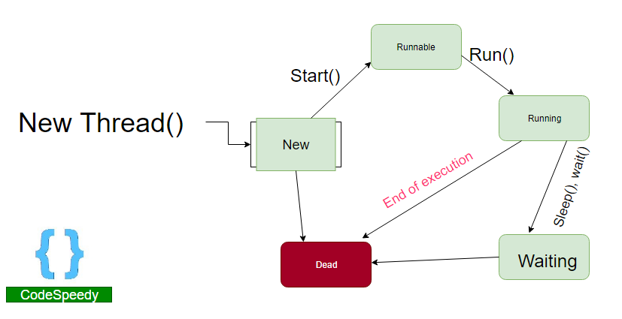
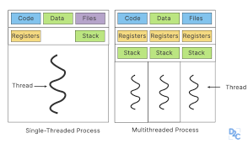
What is Multithreading
It’s a technique in which multiple threads of execution run concurrently within a single process. In simpler terms,
allows multiple tasks to be executed simultaneously or concurrently.
Parallel processing for improved user experiences and responsiveness
Source: Multithreading in Java with Examples - CodeSpeedy Understanding, The Concept Of Multithreading In OS // Unstop (formerly Dare2Compete)

Slide 6
Why Multithreading is Essential for Developing High-Performance Apps ?
Faster Execution: Multithreading allows multiple tasks to be executed simultaneously, which can help reduce the time required to perform complex tasks.
Improved Responsiveness: By moving time-consuming tasks to background threads, the main UI thread remains free, allowing the app to remain responsive.
Efficient Resource Utilization: Multithreading allows efficient utilization of system resources, such as CPU and memory.

Slide 7
What are Flutter isolates?
Flutter isolate is similar to an event loop, with a few differences:
An isolate has its own memory space
It cannot share mutable values with other isolates
Any data transmitted between isolates is duplicated

Slide 8
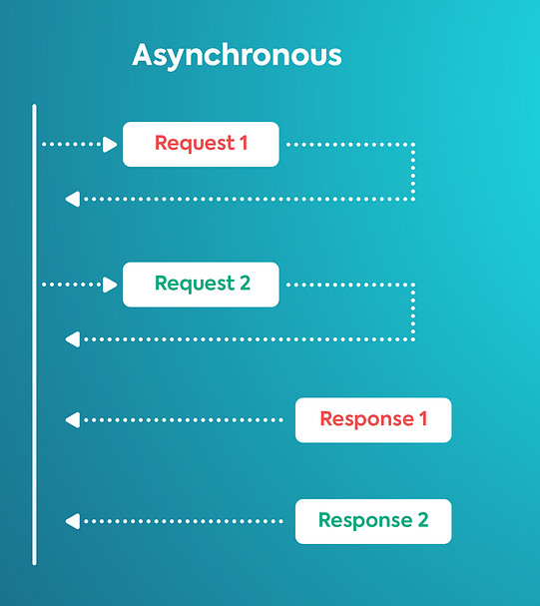
Isolates vs Async
Async
Wait without blocking
Does not do the work in a background thread
It’s a Dart event loop jumping between different parts of your program as needed
Isolate
Have their own event loop and memory
It’s is like a little space in a machine, with its memory and a single thread running an event loop that processes the code

Slide 9
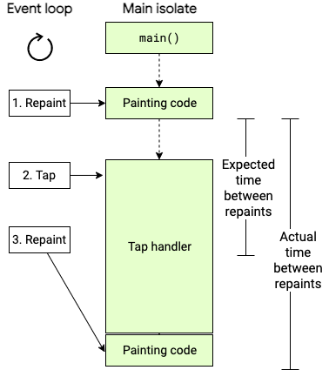
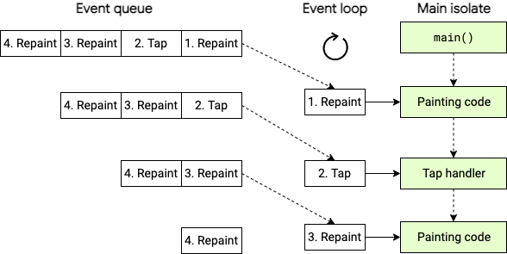
How Flutter isolate works ?
Source: https://dart.dev/language/concurrency

Slide 10
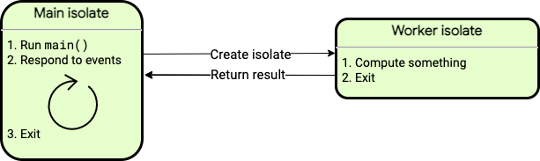
How Flutter isolate works ?

Slide 11
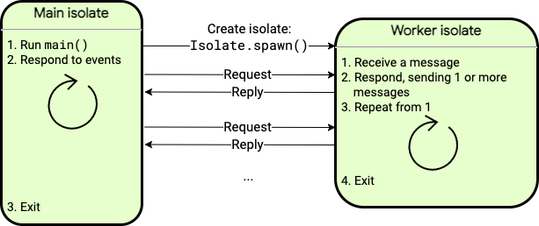
How Flutter isolate works ?

Slide 12
Types Of Isolate In Flutter
Isolate in flutter can be created in these 2 ways :
: Compute function
: Spawn function

Slide 13
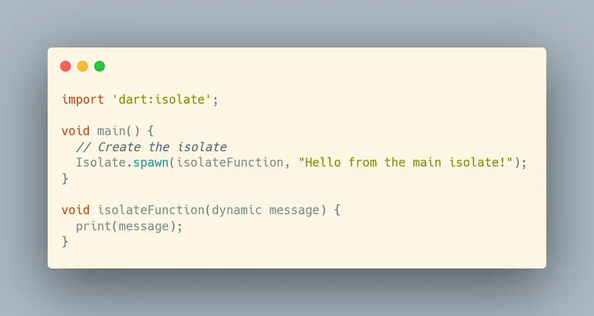
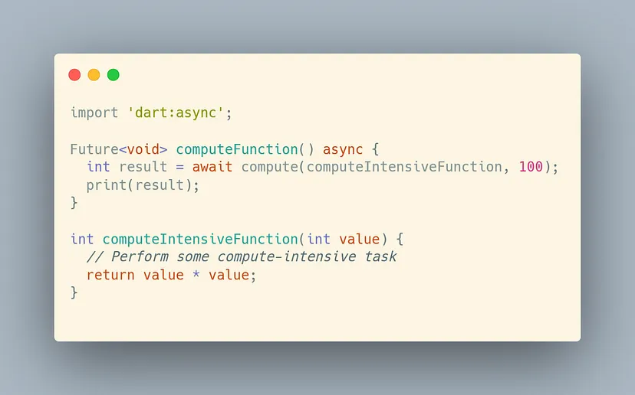
Types Of Isolate In Flutter
Spawn function
Compute function
Source: https://medium.flutterdevs.com/multithreading-in-flutter-aa07e2ae2971

Slide 14
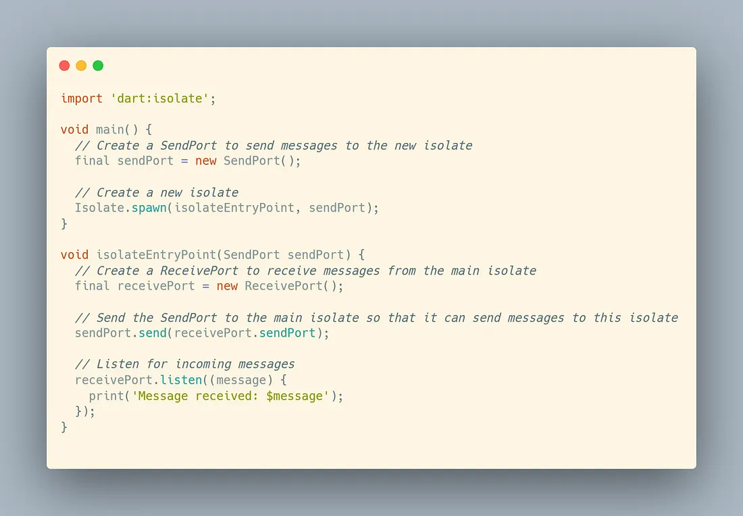
How do Isolates Communicate with each other?
To communicate between isolates, we can use a combination of Send-Port and Receive-Port objects.

Slide 15

A Short Demonstration

Slide 16
Q/A?

